Slide 1
Methods to Predict Patient Survival
Yiwen Yang
Supervisor: Dr.Jian Tang

Slide 2
Introduction to Survival Analysis
Related Work
- Unsupervised Learning
- Hierarchical Clustering
- Supervised Learning
- Median Cut
- Semi-supervised Learning
- Supervised Clustering
- Supervised Principal Components
MRMR + Bayesian Classification
Results and Analysis
Future Work

Slide 3
Survival Analysis
Subtypes are not identified directly or class labels are not computed directly.
The response is often referred to as a failure time, survival time (our gene lung cancer data), or event time with censoring status δi.
- δi = 0: Patient is censored, leaves a study before the study
is completed.
- δi = 1: Patient is completed and failed or died at survival
time.
Example:
Patients | Gene | Survival Time | Censoring Status
A | 10, 110.5, 1113.6, ... | 53.5 | 1
B | 23, 675, 2396.7, … | 1.5 | 0
… | … | … | …

Slide 4

Survival Analysis (CONT.)
Our goal: Divide patient into two subtypes (“high risk” and “low risk”) that are
related to survival.
Kaplan–Meier estimate:
(1)
- tj is failure times, t1<t2<…<tj
- dj is the number of failures at time tj
- nj is the number of observations at risk just prior to time tj
A plot of the Kaplan–Meier estimate yields the Kaplan–Meier survival curve, this is a popular tool for visualizing survival data.

Slide 5
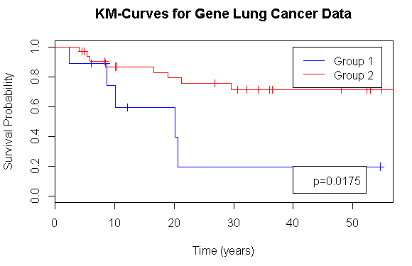
Survival Analysis (CONT.)
Example of Kaplan–Meier survival curve.
Figure 1:KM-Curves for high risk and low risk patients,
respective.

Slide 6


Survival Analysis (CONT.)
Cox proportional hazards model
(2)
- λ(t|xi) is the hazard at time t for observation xi.
- β ∈ Rp is a vector of regression coefficients.
- λ0(t) is the unspecified hazard function.
One method to find β is maximizing the Partial Likelihood
(3)
- D is the set of indices of the deaths
- Rr is the set of the individuals at risk at time tr − 0.

Slide 7
Related Work
- Unsupervised Learning
- Ben-Dor et al. use clustering on a subset of genes.
- Hierarchical Clustering
- Supervised Learning
- Nguyen and Rocke use a form of PLS
- Li and Luan use a form of SVM
- Beer et al. use an ad hoc method
- Median Cut
- Semi-supervised Learning
- Supervised Clustering
- Supervised Principal Components

Slide 8






Premise: Nearest Shrunken Centroids
a modified version of LDA (Linear Discriminant Analysis).
The goal of NSC is to find final version of and that maximize the complete-data log likelihood.
is the fraction of the training instances that belong to the i class.
is the mean of .
Complete-data log likelihood:
(4)
- (5)
- (6)
One condition: class labels are already computed. Then computing
and and fitting the formula (6), which is LDA model.

Slide 9


Nearest Shrunken Centroids (CONT.)
Second condition: EM algorithm is
applied to update and and find
final version of and that maximize
complete-data log likelihood
EM algorithm
- Initialize parameters and .
- E step: Evaluate
- M step: Update the parameters and .Compute the complete-data
log likelihood:
(7)
(8)
(9)
(10)

Slide 10
Hierarchical Clustering(Unsupervised)
“Unsupervised” does not use any of the clinical information (e.g. survival time in our lung cancer data) about the patient.
Hierarchical clustering method:
- Put each training patient points in their own cluster.
- Identify the closest two clusters and combine them into
one cluster.
- Repeat the above step till all the data points are in a
single cluster.
- Cut off the tree of dendrogram at two clusters (i.e. high risk
and low risk)
- Train a nearest shrunken centroids classifier and use it
to classify testing patients to two clusters.
- Compute P value of two clusters of testing patients.

Slide 11
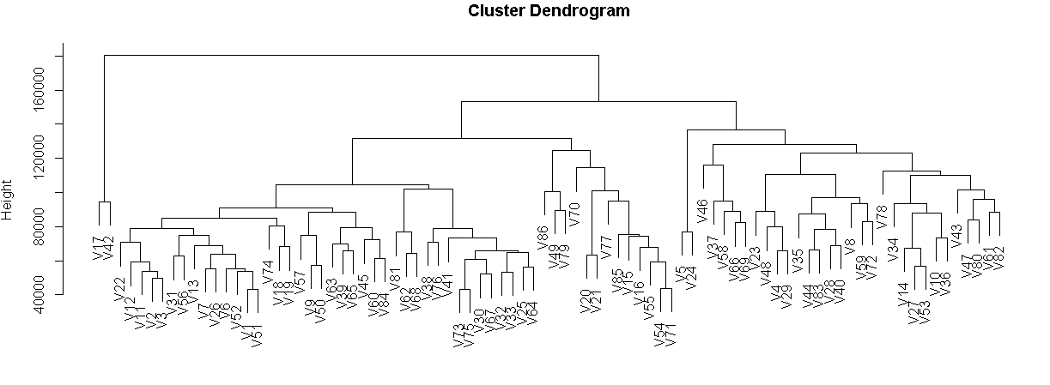
Hierarchical Clustering(CONT.)
Example:
Figure 2. Cluster Dendrogram from our gene lung cancer data, which contains a total of 86 patients with 4752 genes

Slide 12
Median Cut (Supervised)
Supervised use both clinical information (outcome) and genes (features).
Median Cut Method:
- Create median survival time from training data.
- Take median survival time of all the completed patients as
median survival time for all training patients or
- Take turning point in KM graph as median survival time for
all training patients.
- Generate class label for each completed (uncensored) patient
and two probabilities that censored patient belongs to ‘‘low-
risk’’ and ‘‘high-risk’’ subgroup, respectively.
- Assume median survival time is 45 year.
- The completed patients generate class label easily since their
survival time is completed.
- Use KM graph to compute the probabilities for censored
Patients.

Slide 13
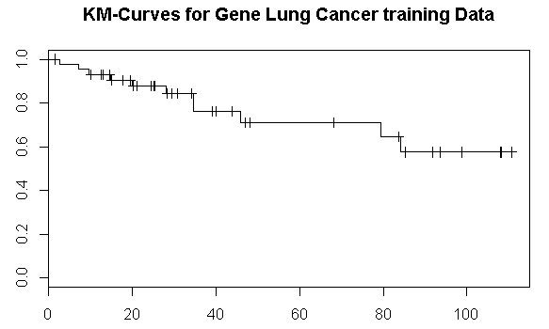
Median Cut (CONT.)
- Use KM graph to compute the probabilities for censored Patients
- Assume a censored patient survival tiime T is 1.5 year.
- Use KM graph to compute P(T>1.5) and P(T>45).
- P(T>45|T>1.5) = P(T>45) / P(T>1.5)
- P(<=45|T>1.5) = 1- P(T>45) / P(T>1.5)
Figure 3.

Slide 14
Median Cut (CONT.)
- The final step of median cut is Train a nearest shrunken centroids
classifier and use it to classify testing patients to two clusters.

Slide 15

Supervised Clustering (Semi-supervised)
Semi-supervised learning is a class of supervised learning combining with unsupervised learning.
Supervised Clustering Method:
- Calculate the Cox score for each gene using univariate Cox scores
(11)
- D is the set of indices of the deaths
- Rr is the set of the individuals at risk at time tr − 0.
- Try M evenly space between the Nth percentile of the Cox scores
and the maximum of the Cox scores.
- Apply 2-means clustering on training patients for each space and
get class labels.
- Train a nearest shrunken centroid classifier for each
space class labels.
- Choose the optimal NSC based on cross validations.

Slide 16

Supervised Principle Components (Semi-supervised)
Let X be the p X n matrix of expression values, for p genes and n patients. In particular, consider the singular value decomposition of X
(12)
(13)
- U is a p X n orthogonal matrix
- D is an n X n diagonal matrix
- V is an n X n orthogonal matrix and every column
of V is seen as a principal component
Each row of V is a linear combination of the expression values in the corresponding column of X
Every element of a column v, can be seen as an integrated gene expression value for a patient.
In this case, the p dimension are reduced to only one dimension
X is reconstructed to consisting of those genes with largest cox scores.

Slide 17



Supervised Principle Components (Semi-supervised)
Then we can maximize partial likelihood to find for fitting the Cox proportional hazards model.
We make a modification on the SPC other than using partial likelihood and cox proportional hazards model.
-Since every element of a column v can be seen as an integrated gene
expression value for a patient, we perform 2-clustering on these
integrated gene and get class labels.
-Train a Nearest Shrunken Centroids model and use it to
classify testing data.

Slide 18
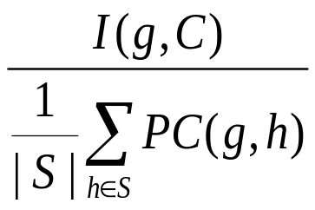
  MRMR+Bayesian (Supervised)
  MRMR: larger implies better
    Notations
      C: set of class labels
      g: feature currently under consideration
      S: subset of features already selected where g ∉ S, initially Φ
      I(g, C) = H(C) – H(C|g) where
        H(C) = -∑_{y∈C} P(y)logP(y) (i.e., entropy of C)
        H(C|g) = - ∑_{y∈C} ∑_{g∈D} P(y, g)logP(y|g), where D = Dom(g)
        H(C|g) is called conditional entropy of C given g
      I(g, C) is the uncertainty deducted from C by presence of g
      It measures correlation (also called relevance) of g and C

Slide 19
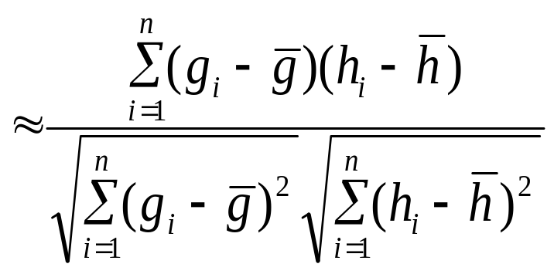
      PC(g, h) = Cov(g, h)/(sd(g)•sd(h))
MRMR:
    PC(g, h) called Pearson Coefficient between g and h
    It measures correlation (i.e., redundancy) of g and h
    ∑_{h∈S}PC(g, h)/|S| is thus the average correlation between g and the members of S

Slide 20
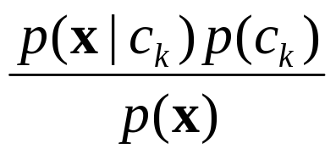
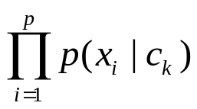

MRMR+Bayesian (CONT.)
Bayesian Model
p(c_{k}|x) =
Since p(x) is the same for all c_{k}, the above is equivalent to classifying x to the class that maximizes p(x|c_{k})p(c_{k} )
  p(x|c_{k}) =
    - p(x_{i}|c_{k}) ≈ where s_{ki} is number of training objects in class k
    that have value x_{i} for attribute X_{i}, and s_{k} is the total number of
    training objects in class k

Slide 21
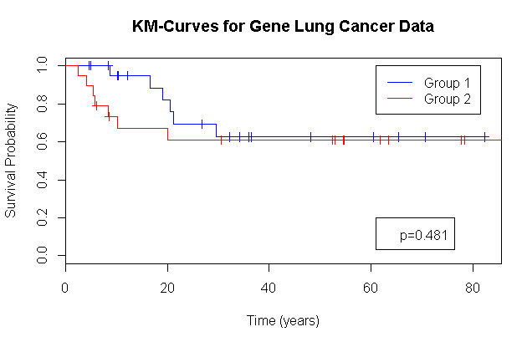
Result and Analysis
Figure 4. Hierarchical Clustering (Unsupervised)
Figure

Slide 22
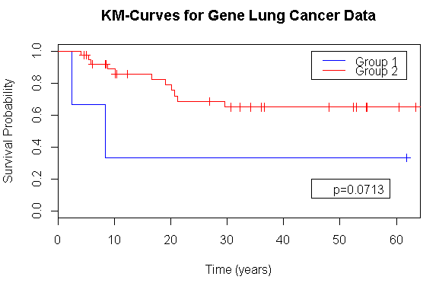
Result and Analysis (CONT.)
Figure 5. Median Cut (Supervised)

Slide 23
Result and Analysis (CONT.)
Figure 6. Supervised Clustering(Semi-Supervised)

Slide 24
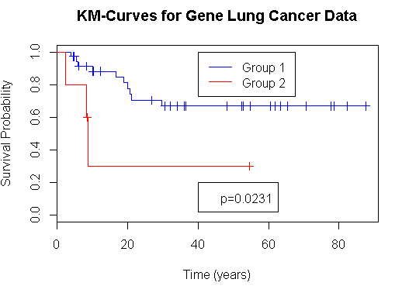
Result and Analysis (CONT.)
Figure 7 Supervised Principle Components (Semi-supervised)

Slide 25
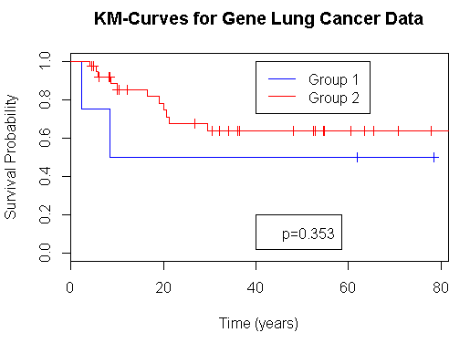
Result and Analysis (CONT.)
Figure 8.MRMR+Bayesian (Supervised)

Slide 26
Future Work
Since Semi-Supervised overpower the Supervised and Unsupervised, a semi-supervised model using MRMR+Bayesian will be developed.
all methods ignore gene-gene interactions which is particular problematic for traditional statistical techniques. Some powerful methods for gene-gene interaction, such as GENN (Grammatical Evolution Neural Networks) will be tested in the future work.

Slide 27
Thank You !!

